Slide 1

INSTITUTE :UIE
DEPARTMENT: ACADEMIC UNIT 1 - 5
Bachelor of Engineering (EE Branch)
Subject Name and Code:
Engineering Physics 23SPH-141
Prepared by: Divya, Assistant Prof. Physics
i
Superconductivity
DISCOVER . LEARN . EMPOWER

Slide 2


COURSE OBJECTIVES
The course is designed to make the students industry ready to contribute in the growing demand of the industry at local, national and international level.
It will make the students competent to understand basic concepts and applications of advanced engineering physics and apply its principles in their respective fields at global platform.
It will enhance the skill level of the students and shall make them preferred choice for getting employment in industry and research labs.
It will give thorough knowledge of the discipline to enable students to disseminate knowledge in pursuing excellence in academic areas.

Slide 3
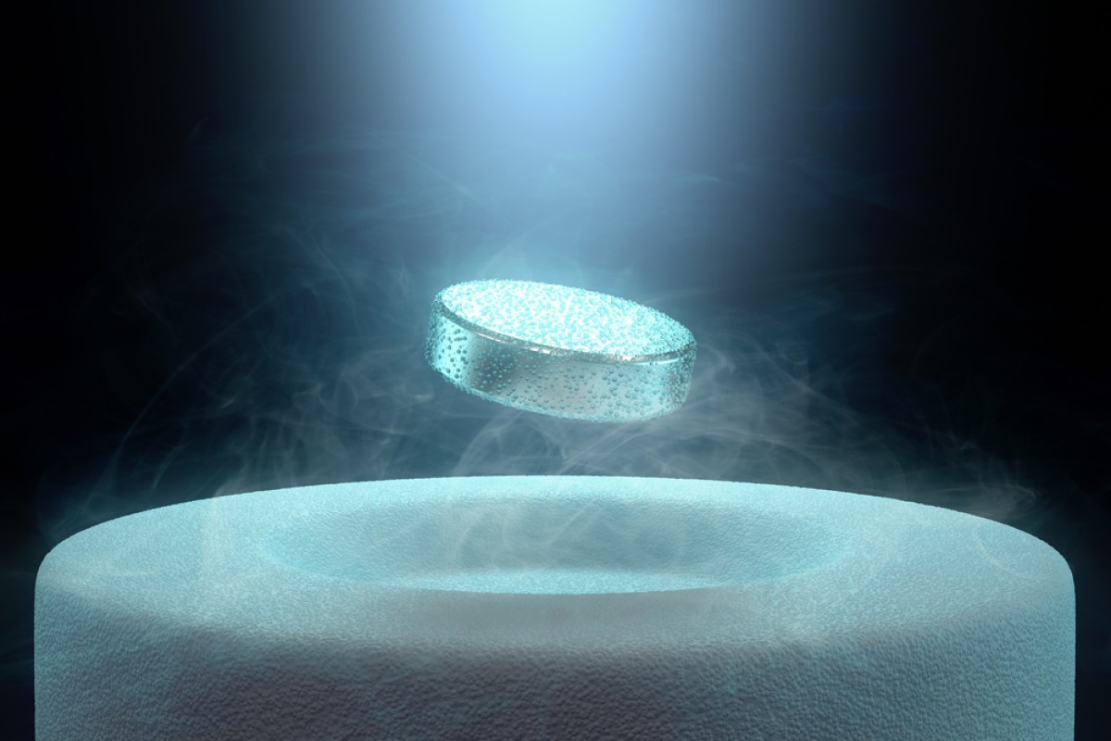
Course Outcomes
CO Number | Title On completion of this course, the students are expected to learn | Level
CO1 | To identify various components of laser and optical fibers and justify their importance and applications in different fields of science and technology | Understand Applying
CO2 | The basic concepts of semiconductor physics, illustrate the working of various semiconductor components and use its principles in design of optoelectronic devices and its applications. | Understand Applying Analyze
CO3 | To understand the principles of superconductivity and their applications. To illustrate the propagation of em waves. | Understand Applying

Slide 4
Content
TYPE-1 AND TYPE-2 SUPERCONDUCTORS
APPLICATIONS OF SUPERCONDUCTORS

Slide 5
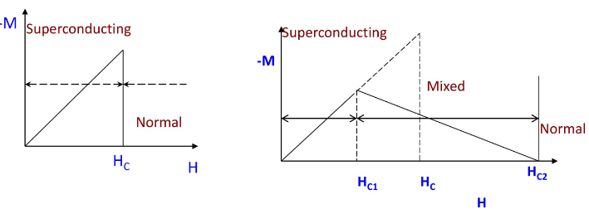
Type-1 and Type-2 Superconductors
TYPE-1 | TYPE-2
Type-I superconductors are generally pure metals | Type-II superconductors are generally alloys and complex oxides of ceramics.
These are completely diamagnetic. | These are not completely diamagnetic
These are also called as Soft Superconductors. | These are also called as Hard Superconductors.
No mixed state exists in type-I Superconductors | A mixed state exists in type-II Superconductors.
Perfectly obey the Meissner effect: Magnetic field cannot penetrate inside the material. | Partly obey the Meissner effect but not completely: Magnetic field can penetrate inside the material.
TYPE-1
TYPE-2

Slide 6
Type-1 and Type-2 Superconductors
TYPE-1 | TYPE-2
Easily lose the superconducting state by low-intensity magnetic field. Therefore, type-I superconductors are also known as soft superconductors. | Does not easily lose the superconducting state by external magnetic field. Therefore, type-II superconductors are also known as hard superconductors.
The transition from a superconducting state to a normal state due to the external magnetic field is sharp and abrupt for type-I superconductors | The transition from a superconducting state to a normal state due to the external magnetic field is gradually but not shape and abrupt. At lower critical magnetic field (H_{C1}), type-II superconductor starts losing its superconductivity. At upper critical magnetic field (H_{C2}), type-II superconductor completely loses its superconductivity. The state between lower critical magnetic field and upper magnetic field is known as an intermediate state or mixed state.
Exhibits single critical magnetic field. | Exhibits two critical magnetic field

Slide 7
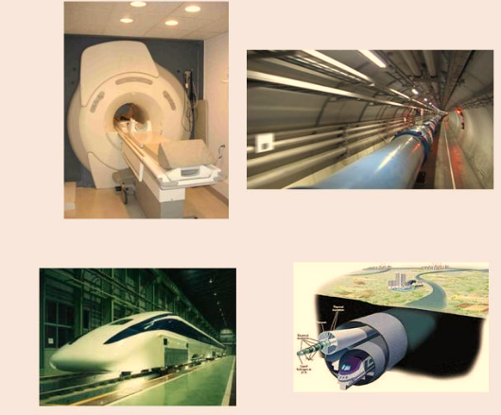
Applications of Superconductivity
MRI BODY SCANNERS
ACCELERATOR MAGNETS
MAGNETOMETERS FOR MEDICINE, SEISMOGRAPHY
TRANSPORT

Slide 8
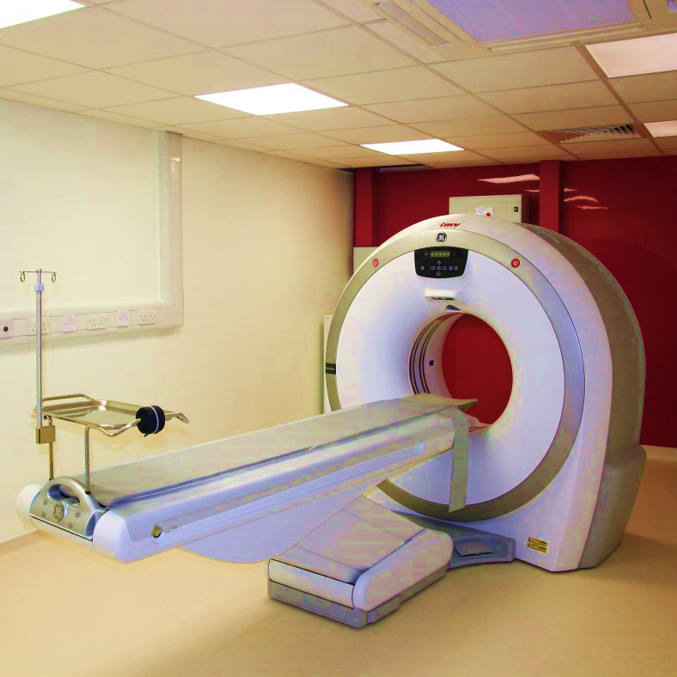
MRI Body Scanners
The superconducting magnets have been employed in NMR Spectrometers and NMR imaging is used in medical diagnostics.
On applying a strong superconductor derived magnetic field into the body, hydrogen atom that exist in the body’s water and fat molecules are forced to accept energy from the magnetic field. Then they release this energy at a frequency that can be detected and displaced graphically by a computer.

Slide 9
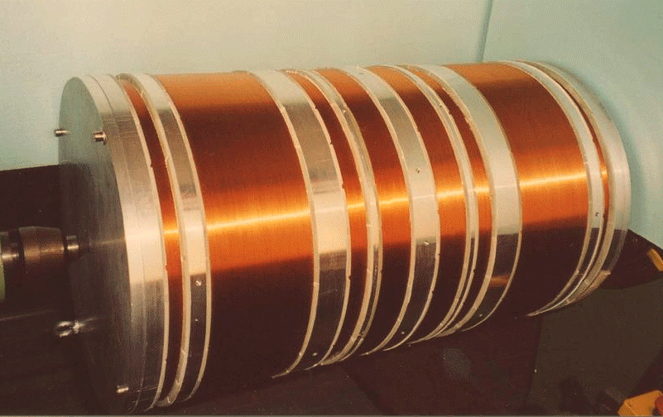
Accelerator magnets
Low temperature liquid helium superconductors have been used to fabricate high field magnets.
We know electric field in the wire creates magnetic field around the wire. The strength of magnetic field increases as the current in the wire increases. Since SC’s can carry large currents without energy loss, they are well suitable for making strong magnets.

Slide 10
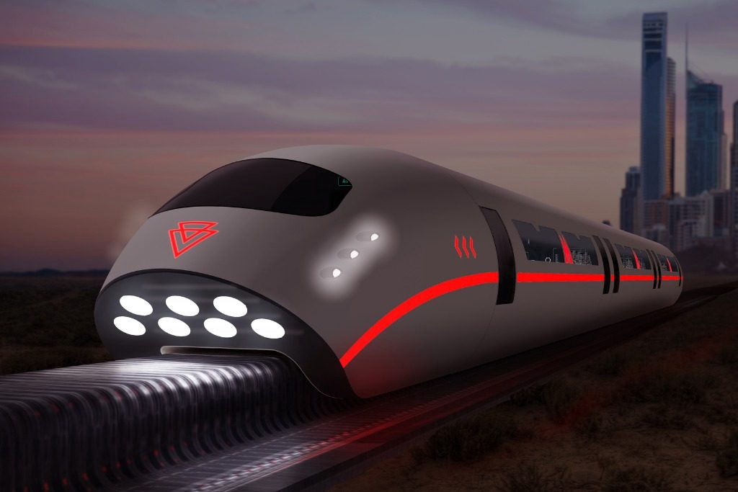
Maglev trains
For high speed magnetic trains superconductors are used
The maglev train system works by utilizing magnetized coils running along a track that attract and repel large superconducting magnets in the train’s undercarriage and allow it to levitate almost four inches above the ground.
Power supplied to the coils in the guideway then creates polarizing forces that pull and push the train along.

Slide 11

FAQs
What are type-1 and type-2 Superconductors?
How many critical fields are there in Type-2 Superconductors?
Which type of Superconductor shows complete Meissener effect?
How Superconductors are used in maglev trains?

Slide 12
ASSESSMENT PATTERN
MST(02)
20 marks
Quiz
4 marks
Attendance
(>90%)
2 marks
Surprise test
4 marks
Assignment
10 marks

Slide 13
Reference books and weblinks
A. Z. Jones. "What is Quantum Levitation (and How Does it Work?)." Internet: physics.about.com/od/quantump...Levitation.htm.
S. O. Kasap. Principles of Electronic Materials and Devices. New York: McGraw Hill, 2006, pp. 729-736.
"Superconductivity: The Meissner Effect, Persistent Currents and the Josephson Effects." MIT Department of Physics, Feb. 8, 2011.
http://lampx.tugraz.at/~hadley/ss2/problems/super/s.pdf
https://www.ques10.com/p/31387/distinguish-between-type-i-and-type-ii-superconduc/

Slide 14
Reference books and weblinks
https://www.toppr.com/ask/question/write-any-five-applications-of-superconductors/
https://www.rsc.org/Education/Teachers/Resources/Inspirational/resources/4.5.2.pdf

Slide 15
Reference Video links
https://www.youtube.com/watch?v=AX962gXo0CI
https://www.youtube.com/watch?v=fnMoQurFhSs
https://www.youtube.com/watch?v=2xOAb68agy0
https://www.youtube.com/watch?v=uMExoSVKhLE

Slide 16
THANK YOU
divya.e8645@cumail.in

